Slide 1

Feasibility of AguaClara Plants in Puerto Rico
Flamingos
Ben Diskin, Clare O’Connor, Thomas Suesser
Notes:
Over the course of this project we became experts in filtration...spreadsheet filtration

Slide 2



Water in Puerto Rico
- PRASA & non-PRASA
- Original focus: effect of Hurricane Maria
- Many systems meet EPA standards
-100,000 people on non-PRASA systems
Notes:
Clare
Our focus is on the out of the network non-PRASA systems, because they are not overseen by the government other than testing and regulatory requirements. In general they are less reliable as water systems, in terms of frequency of violations.
With the Hurricane, having water even when the power goes down is something important which is why an AC plant might make sense

Slide 3
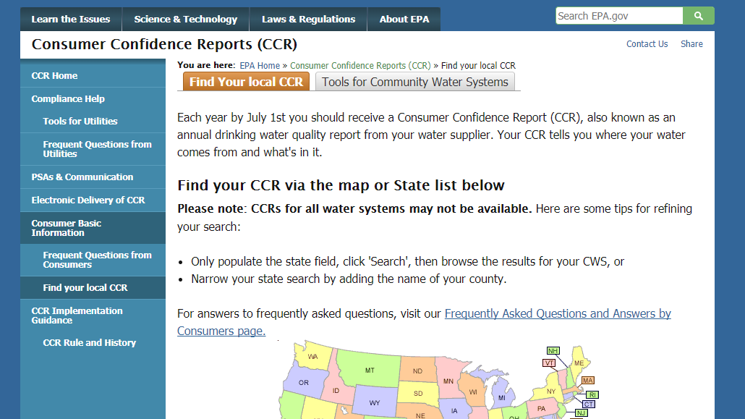
Our Search Process
- Surface water systems
- Population served less than 3000
- Community water systems
- Combine the CCR data with EPA Water Systems Violation reports
- Violations only in the past 5 years
Notes:
Clare
B/c this is what AC plants are capable of treating
-assuming up to 10 1L/s plants can be combined in series leading to 10*300 people per plant
Other EPA water system designations include transient non-community and non-transient non-community
CCR only listed plants and where to find them, but not able to sort by system designation or violation type
Data goes back many years, but to make it approachable to us we decided only to look at violations within the past 5 years

Slide 4

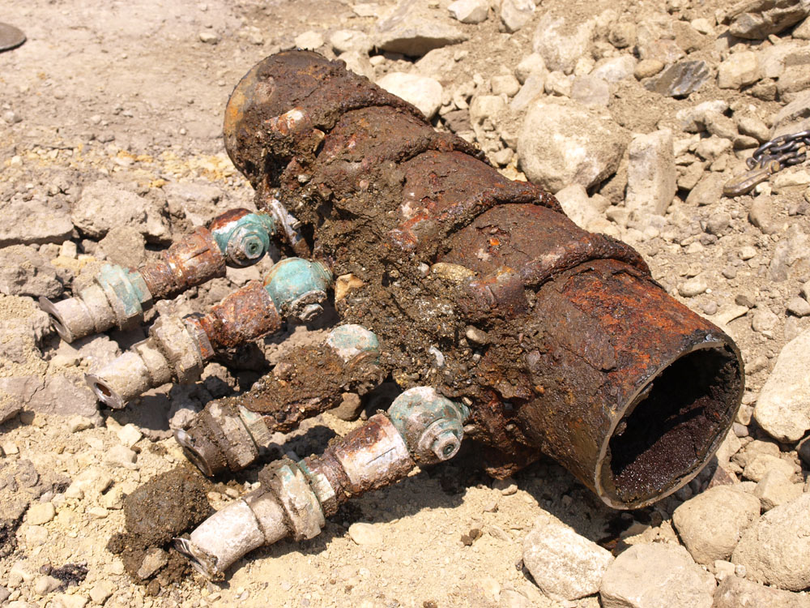
EPA Rules
- Total Coliform
- Surface Water Treatment
- Lead and Copper
https://www.cleanwateraction.org/sites/default/files/images/features/Corroded%20Pipe%20with%20lead%20service%20fittings_1000x750_credit_Mike%20Thomas_Creative%20Commons.jpg
http://enrepinc.com/wp-content/uploads/2017/03/EPA-Logo.png
Notes:
Ben
Total coliform rule is a rule stemming from the need to keep coliforms out of drinking water. The presence of coliforms in water may indicate the presence of disease-causing organisms in the water.
-there are specific rules for number of samples that need to be collected
-if a given level of coliforms, then further samples and tests may have to be conducted for fecal coliforms or E coli
Surface water treatment based on EPA rules about giardia lamblia and Legionella viruses, done through the treatment processes and filtration
-filter specific rules for turbidity of the water coming out of the plant
The EPA has set rules to deal with lead and copper in water; for lead, the limit is 15 parts per billion (ppb) and for copper, the limit is 1.3 parts per million (ppm)
-failure based on the treatment plant itself or if lead/copper detected in 10% of taps sampled

Slide 5
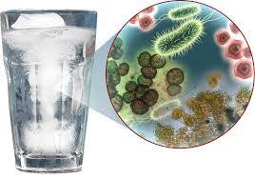
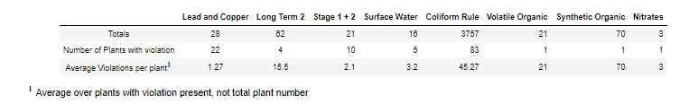
Some trends we noticed
- Many small plants failed TC Rule every time they were tested
- Smaller plants failed to meet standards more often in general
Notes:
Ben
Total coliform rule was violated every month tested over a 5 year period for many plants
-smaller plants failed more often
Another common rule violation was the lead and copper rule, violated at 22 plants
A third rule we looked at was the surface water rule and long term 2 (an addition to the surface water rule), which is a rule we believe AguaClara would have a significant impact on addressing
There were a total of 9 violations of those rules

Slide 6
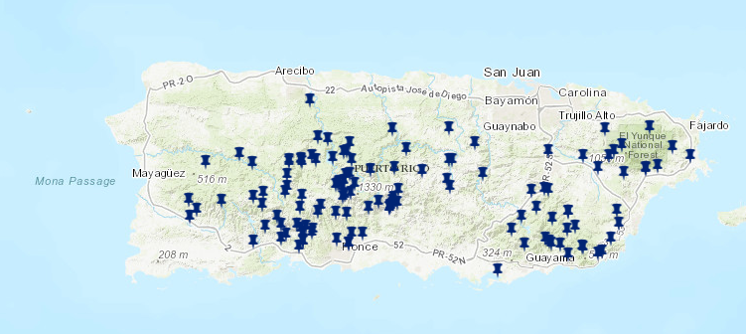
We wanted to visualize this data and make it more user friendly
Notes:
Thomas
Started from 2 reports, wanted to compile into format easiest to navigate
As people not super familiar with Puerto Rico’s geography, maps helped us find patterns

Slide 7
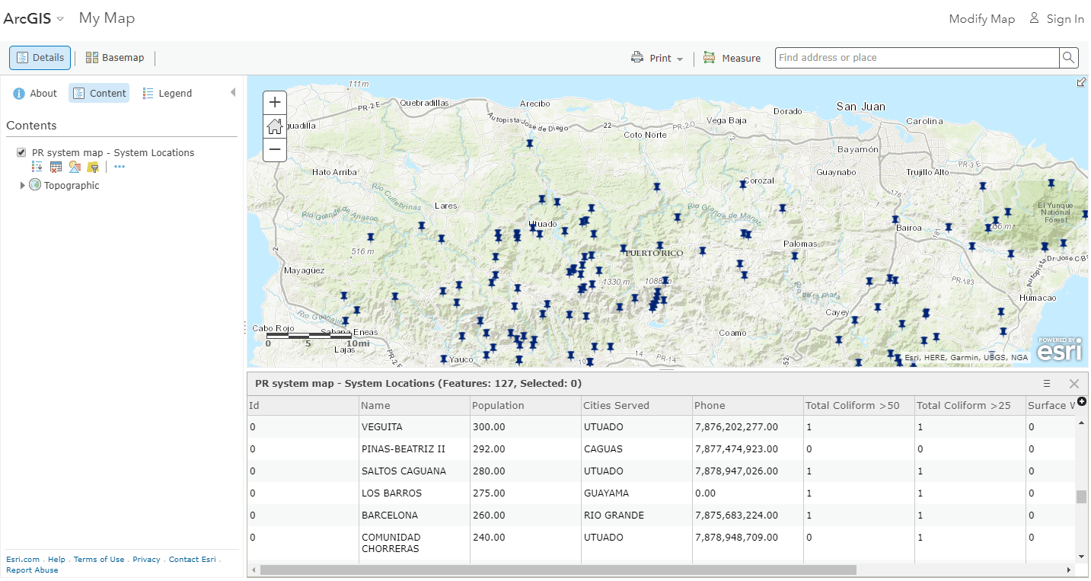
AguaClara is open-source, ArcGIS online is a publicly available tool
Notes:
Link to this map is public
Different base maps
Search and filter just like in the EPA reports
Adds a spatial, visual aspect
Users can save their own versions of the map with their own display settings without changing the public version

Slide 8
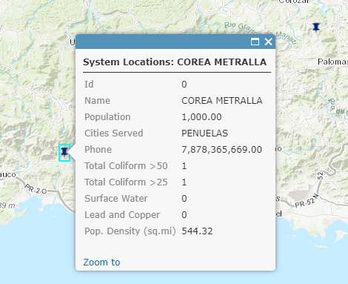
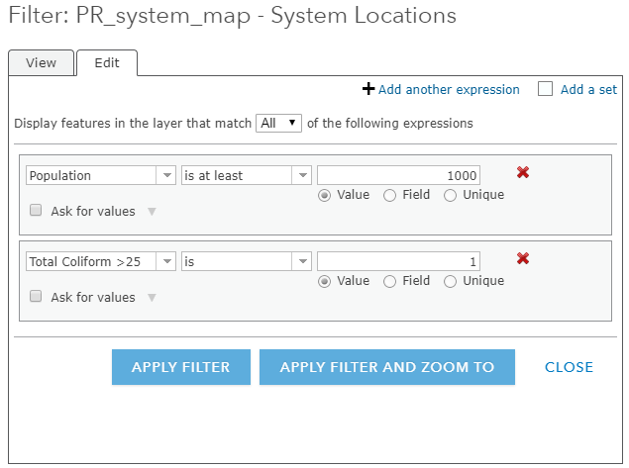
Map helps with the “Where do we start?” dilemma
Notes:
Filter capacity allows us to make decisions about which places to pursue AguaClara more actively
“Where” do we start?

Slide 9
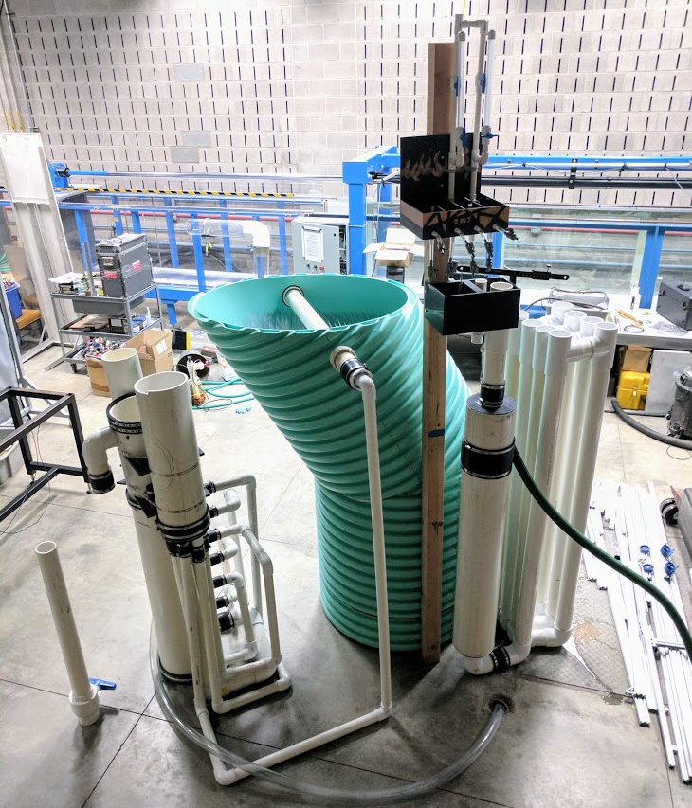
What this can mean in the future
Top 2 Plants Chosen based on Violations of the Total Coliform Rule
Periche (population served: 1,100)
Corea Metralla (population served: 1,000)
Top 2 Plants Chosen based on Violations of Surface Water Treatment Rule
Yahuecas (population served: 2,840)
Guilarte (population served: 2,090)
Notes:
Ben
These were based on violation type (TC or SW), population served (<3000), population density of surrounding area(<1000) based on urban vs rural cutoff
Although AguaClara plants use PVC and easily address lead and copper, as mentioned before, plants currently failing LCR were left out because it is not possible to know if they are not meeting the standard because of their components or the piping components of the end user. Both would result in a failure to meet the LCR.
Image from Prefab 1L/s Fall 2017 Symposium Presentation
2 plants for total coliform
Periche (Good/Rural)
Population served: 1,100
Violations in past five years: 35
Location: San German (population density: 652.55)
Corea Metralla (Good/Rural)
Population served: 1,000
Violations in past five years: 50
Location: Penuelas (population density: 544.32)
2 plants chosen for surface water rule
Yahuecas
Population served: 2,840
Violations in past 5 years: 4
Location: Adjuntas (population density: 625.11)
Guilarte
Population served: 2,090
Violations in past 5 years: 1
Location: Adjuntas (population density: 625.11)
two full lists of 5 plants in each category were assembled and are available in our report

Slide 10
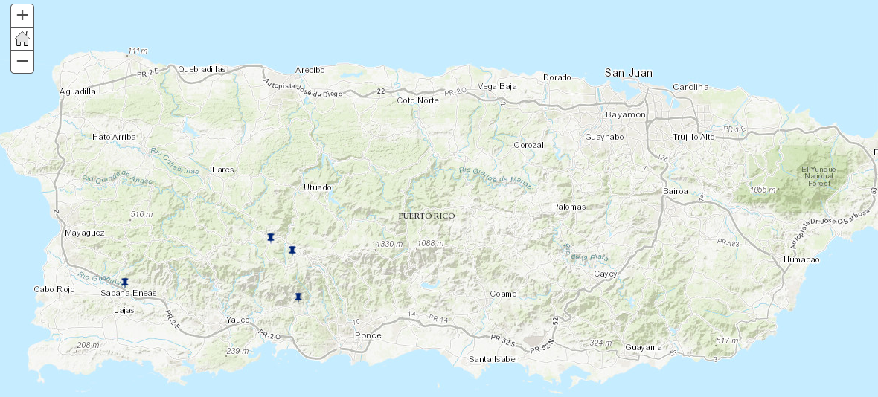
The 4 Plants shown visually
Notes:
Ben
Not too close to the coast, located in the rural more mountainous regions of PR

Slide 11

Cost Analysis
- Good questions are better than bad conclusions
Notes:
Thomas

Slide 12
Cost Analysis
- Good questions are better than bad conclusions
- Local labor means significant variation by location
- Puerto Rico minimum wage is 7.25 (the equivalent hourly wage in Honduras is 1.46 USD)
- Treatment: $2 for 1,000,000 liters based on cost of Calcium hypochlorite
Notes:
Thomas

Slide 13

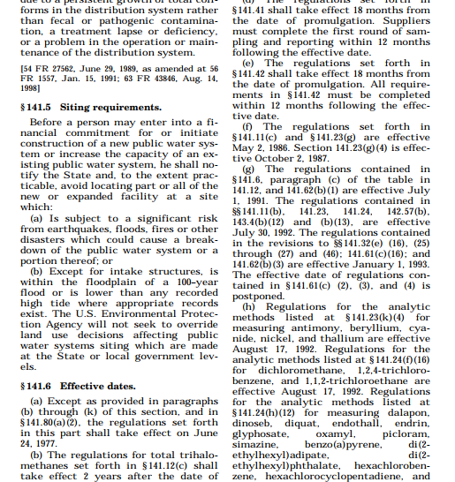
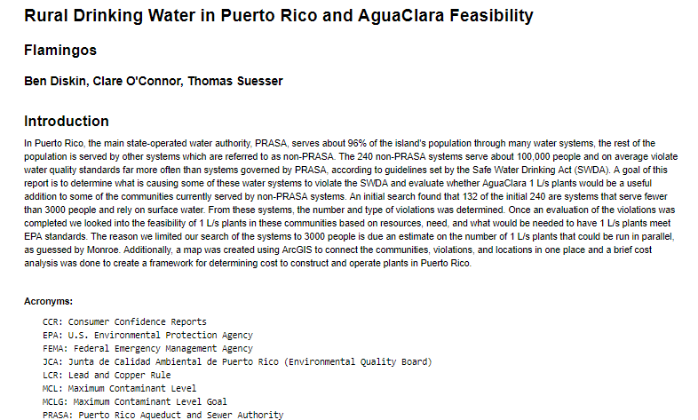
How can our setup and information be used by others?
- Starting point for future investigations!
- Fun map to play with
- Succinct description of EPA rules and links to pages of more information
Notes:
Clare
-Having the violations in one, easy-to-sort place means search for a set of criteria becomes really easy to sort out what you want and look at several things to determine what is needed.

Slide 14
Questions?
Notes:
Clare

